Slide 1
FEM2401 Malaysian Politics & Society TOPIC 11: SOCIETY AND NATIONAL IDENTITY
Lecturer:
MUHAMMAD AMIR BIN MUNSHI

Slide 2
CONTENT:
Social cohesion
National integration and unity
National identity
Nation building process
Patriotism
LEARNING OUTCOME:
To understand the social cohesion and national identity
To discuss the process of national integration in Malaysia

Slide 3
MALAYSIAN SOCIETY
Malaysia is a multi-ethnic society that consists of various ethnic groups. Due to the British colonial, Malaysians used to be described as what J.S Furnival defined, as a plural society refers to a mixed society of various races. However, the mix in this sense means interaction but not merging.
Each group practices its respective religion and customs, cultures, language, ideologies and lifestyles. This multiracial society lives side-by-side, but separated in one political unit. Economically, there exists a division of jobs according to race or ethnicities. After Independence, the country faced various internal problem, esp those related to unity and inter racial integration.
Malaysian society is made up of various ethnic groups (majority and minority; natives and non-natives)
(a) Peninsular Malaysia: Malays, Chinese, Indians and Orang Asli
(b) Sabah: Kadazan-Dusun, Chinese and Malays (many other natives)
(c) Sarawak: Dayaks (Iban, Bidayuh and Ulu) Melanau-Malays and Chinese (many other natives)

Slide 4
As a country of diverse races, cultures and religions, Malaysia is unique in proving how its diversity could be united and harnessed for nation building.
National unity is vital to the country as a key to maintain the stability. After Independence, the country faced various challenges, problem, especially related to unity and inter-ethnic integration.
The government has provided many integration programs and policies to unite the society

Slide 5
SOCIAL COHESION: DEFINITION
Anna Rita Manca (2014): Social cohesion is a social process which aims to consolidate plurality of citizenship by reducing inequality and socioeconomic disparities and fractures in the society. It reflects people’s needs for both personal development and a sense of belonging and links together individual freedom and social justice, economic efficiency and the fair sharing of resources, and pluralism and common rules for resolving all conflicts.
Social cohesion refers to the extent of connectedness and solidarity among groups in society. It identifies two main dimensions: the sense of belonging of a community and the relationships among members within the community itself.

Slide 6
UNDERSTANDING SOCIAL COHESION
Social cohesion – related to the concept of integration and unity
The concept of unity and integration are commonly used interchangeably, yet not totally the same. It is interconnected which both aims at bringing different ethnic groups, closer together -united.
Integration – a process of unifying among society in various aspects such as economics, politics and social. This concept is wider than unity.
Unity - a process of forming a national identity among groups differentiated in many aspects such as beliefs, cultures, politics, sociology and location in a political unit.

Slide 7
SOCIAL COHESION IN MALAYSIA
Social cohesion in Malaysia - to describe a work-in-progress towards national unity in Malaysia. Also, it is a current status of Malaysian unity.
Literally, unity = the state of being united
NATIONAL UNITY is the main aim of Malaysia. It is the basis and goal for each program and public policies in Malaysia.
In Malaysian context – National unity is a process to unite various groups that have different social and cultural background into one physical entity. For example, the effort of uniting Sabah, Sarawak and the Peninsular of Malaysia into a federation, is an effort at achieving national unity.
It also understood as a process of forming a national identity among various groups that have differences in beliefs, cultures, customs, politics, social, economic functions and location into a political entity – Malaysian identity
NATIONAL INTEGRATION is part of the process in achieving the national unity.
Integration has a wider meaning as compared to unity. It is a process of uniting groups with different backgrounds into one entity which is bound by common norms, values and interests.

Slide 8
Integration is an act of bringing people from diverse background and culture to be united, yet at the same time keeping their original identity without changing it.
Integration is a highly normative concept consisting of complex and multi layered economic, social and cultural practices especially when applied in the context of nation-building.
When the integration takes place, there will be a sense of belonging and ties of feelings between people themselves. There will be a sharing of heart and minds that goes beyond cultural and ethnic differences. It is difficult, challenging and long process but efforts must be always there to achieve the national integration.
The national integration becomes the ultimate aim of the government to ensure stability and national development.
In Malaysia – there are various national integration program and policies take place since the independence. This includes developing the national identity of Malaysia through nation building process and aiming to instill the values of patriotism.
National identity is a sense of a nation as a cohesive whole, as represented by distinctive traditions, culture, and language. Also, can be defined as a sense of belonging to one country or to one nation with its history, commonly perceived values, and traditions.

Slide 9
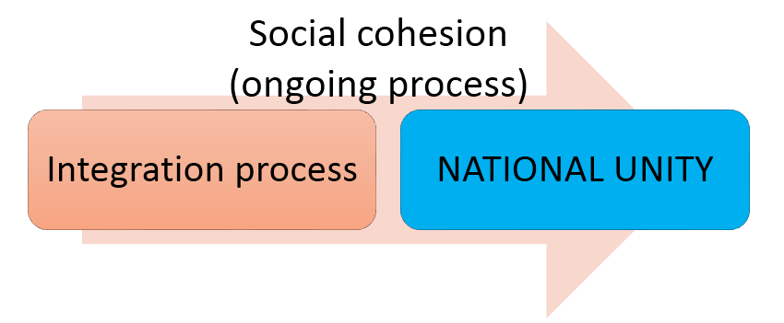
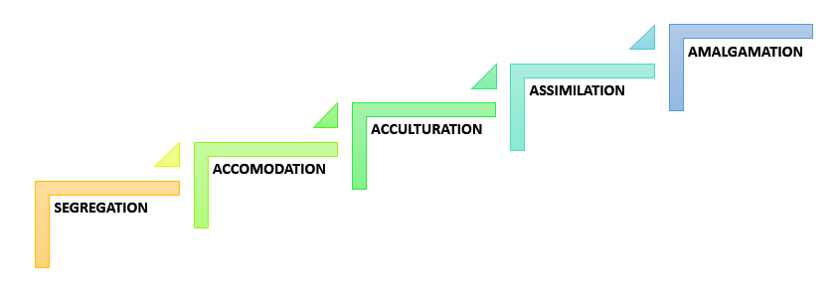
UNDERSTANDING THE PROCESS OF INTEGRATION

Slide 10
Segregation
Segregation refers to the physical separation of two or many groups, particularly in residence, workplace and social functions. Two types of segregation de jure segregation (segregation that is enforced by law) and de facto segregation (segregation that occurs without laws but because of other factors).
Example of de jure segregation is the apartheid movement of South Africa, which existed from 1948 to 1994. Under apartheid, black South Africans were stripped of their civil rights and forcibly relocated to areas that segregated them physically from their white compatriots. Only after decades of degradation, violent uprisings, and international advocacy was apartheid finally abolished.
De facto segregation happens due to many reasons such as segregated by neighborhood, district, language or geographical area. It cannot be easily abolished by law or any court mandate.
Accommodation
A process by which individuals and groups aware of each other’s values and norms and make the necessary adjustments to social situations to prevent or reduce conflict in order to carry on together in their varied life activities.
This is seen as the first stage towards integration. Ethnic groups are aware of each other’s norms and values – they still continue to safeguard their own living culture .
They live in harmony and respect one and another.

Slide 11
Acculturation
This process is known as cultural assimilation. An adaptive process by which a group acquires, retains and/or relinquishes distinctive characteristics of its culture or traits to conform to those of the dominant group.
A minority group accepts the norms, values and patterns of behavior (culture ) of a majority group. Process of borrowing or accepting the cultural elements of the majority group, without changing the original cultural elements.
Assimilation
A process of boundary reduction that sees groups incorporating elements of the dominant group’s culture and traits while still maintaining their own distinctive ethnic and cultural identities.
There is a blending of behaviors and values through social interaction leading to greater homogeneity in society.
In some countries such as Indonesia and Thailand - Entry into a dominant society through friendship and close connection. One-way process of unity, which will generate one culture, one language and one religion.

Slide 12
Amalgamation
This construct is regarded as the highest level of integration and is viewed as an indicator that social distance between groups is weakening and ethnicity is becoming less salient.
It is a process that happens when culture or race mixes to form types of new culture and race (US). Usually happens through inter-marriage between ethnic groups or races and involve biological combination (mixed marriages) this process will produce a new group with a new culture.
Amalgamation creates “melting pot”. Example: US society?
This process may take several generations.

Slide 13

SOCIAL COHESION IN MALAYSIA: CHALLENGES
Achieving national unity is not an easy task. Yet, Malaysia’s story This is due to the existence of economic, social, cultural, residential and world view among the people.
Therefore, the Malaysian government since the independence of the country has put endless efforts towards achieving the national integration.
Multi-ethnic society – is the key to national unity
The condition of Malaysia = stable tension
ISSUES and CHALLENGES
Before 1969
Divide and conquer
Japanese occupation
Suspicion between races
Differences in religion, culture and language
Education system
Socio-economic disparities
Racial politics
Segregation / Physical separation (place of residence and work)

Slide 14
LESSONS FROM 13 MAY 1969
Uphold democracy
Importance of living together
Love for the country
Abide by the law and the constitution
Unity is the key to social welfare

Slide 15
Effort Towards Unity And National Integration
Economy
New Economic Policy (MP 1971-1975) NDP
Social
Rukun Negara
National Education Policy
National Cultural Policy
1Malaysia
Malaysian Nation
Respect
Relationship beyond ethnic lines
Politics
Sedition Act 1948 (Amendment 2012) – Power sharing

Slide 16
Government efforts to increase PATRIOTISM
Celebrating national events such as Independence Day, Malaysia Day, Youth Day, participation in cultural and religious celebrations of ethnic groups such as Hari Raya (Muslim), Chinese New Year (Chinese), Deepavali (Indian), Gawai Day (Iban) etc, National Open House.
Programs like BTN (National Civics Bureau Courses) and PLKN (National Services)
Empower the national language (Bahasa Melayu)
Unity in Education Policy- national education system

Slide 17
NATIONAL IDENTITY
National identity can be defined as an example of an exclusively unique trait among different nations.
Huntington (1997) - national identity can be perceived as a theoretical construct that is formed based upon a number of distinctive factors associated with a particular culture practiced inside a particular political state.
National identity associated with the culture of a society, individual members of that society may develop a personal and social identity that is in accord with its dominant personal and social values.

Slide 18
NATIONAL IDENTITY = nation building process?
Federal Constitution
Compromise between the races
Bahasa Melayu as the national language
Islam as the religion of the Federation
Religious freedom
Rukun Negara = National Ideology
Philosophy that respects and celebrates diversity
“Malaysian Nation”
Vision 2020 – Tun Mahathir
One Malaysia – Dato’ Seri Najib Tun Razak
National Education system – national school
National Cultural Policy – 3 pillars

Slide 19
RUKUN NEGARA (NATIONAL IDEOLOGY)
Rukun Negara was formalised in 31 August 1970
Response to the ethnic riot tragedy of 13 May 1969
Objectives of Rukun Negara are directed towards developing a modern and progressive nation where the people together enjoy the nation’s riches in a fair and just manner, in a peaceful environment, respecting each other, despite ethnic and cultural differences.

Slide 20
RUKUN NEGARA (NATIONAL IDEOLOGY)
WHEREAS OUR COUNTRY MALAYSIA nurtures the ambitions of: achieving a more perfect unity amongst the whole of her society; preserving a democratic way of life; creating a just society where the prosperity of the country can be enjoyed together in a fair and equitable manner; guaranteeing a liberal approach towards her rich and varied cultural traditions; and building a progressive society that will make use of science and modern technology. NOW THEREFORE WE, the people of Malaysia, pledge to concentrate the whole of our energy and efforts to achieve these ambitions based on the following principles:
BELIEF IN GOD
LOYALTY TO KING AND COUNTRY
THE SUPREMACY OF THE CONSTITUTION
THE RULE OF LAW
MANNERS AND MORALITY

Slide 21
CONCLUSION
Malaysia – multi-ethnic society with a unique historical background and challenges. Maintaining the racial harmony and social stability are the main priority of the government.
All program and policies in Malaysia are meant for social cohesion, national unity and integration

Slide 22
Reflection
What is the meaning of social cohesion and national unity?
What is the stage of national unity and integration in Malaysia?
What are the examples of Malaysian government efforts in maintaining the social and racial harmony of the multi-ethnic society?

